Slide 1
Solutionary GmbH
Digitalization of Business Processes
Jan Lindegger, Joel Engel, Florian Jutzi
Team Ricotta

Slide 2
Team Ricotta
agenda
01 INTRODUCTION
Our welcome
message for you.
02
CASE
Description of our
As-is process
03
PROBLEMS
What do we want to improve
04
TO-BE PROCESS
How does our solution looks like
05
VIDEO / DEMO
Enjoy the video about the implemented solution
06
BENEFITS
What advantages could we generate
07
DISCUSSION
Discussion about our solution and time for questions
08
END
Thank you for listening and participating

Slide 3
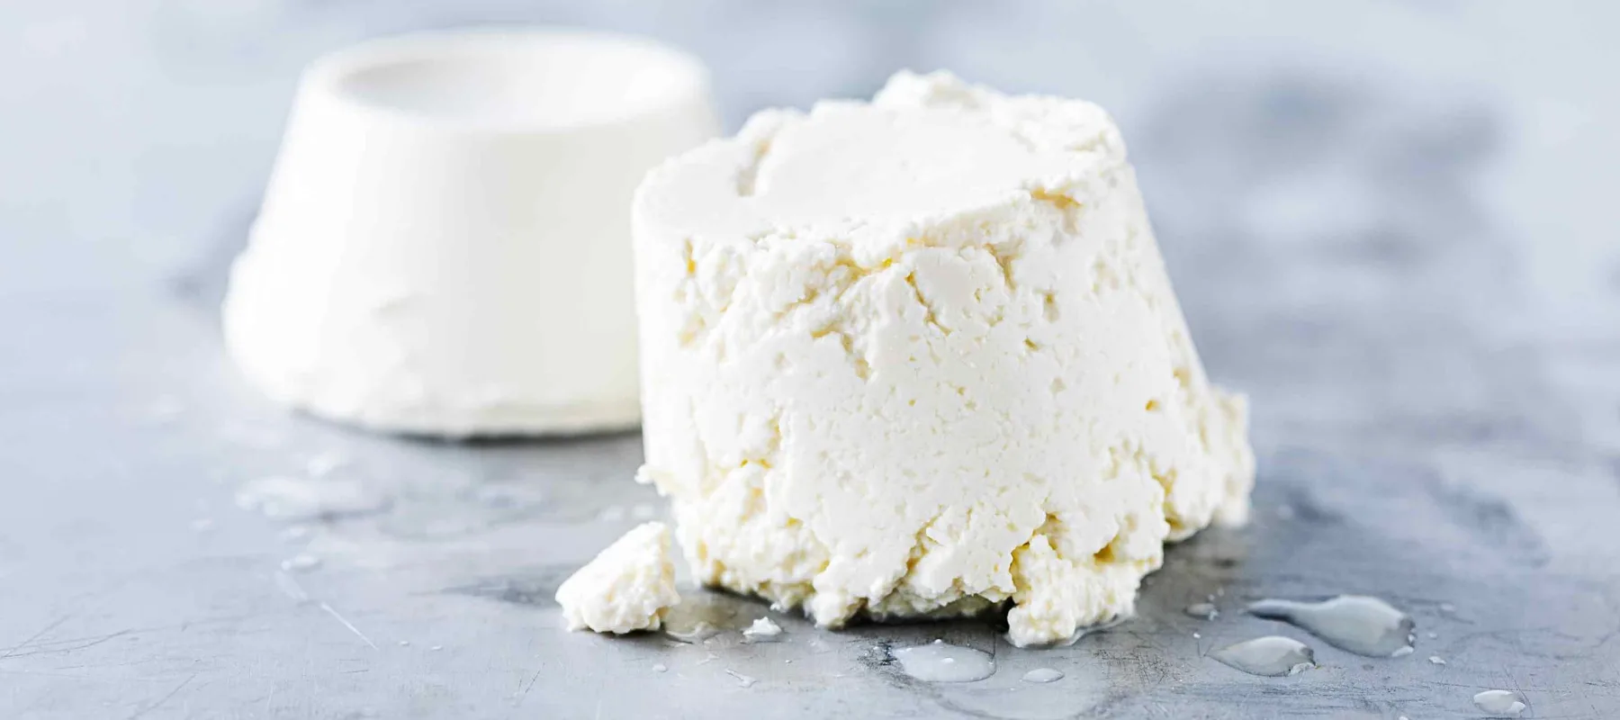
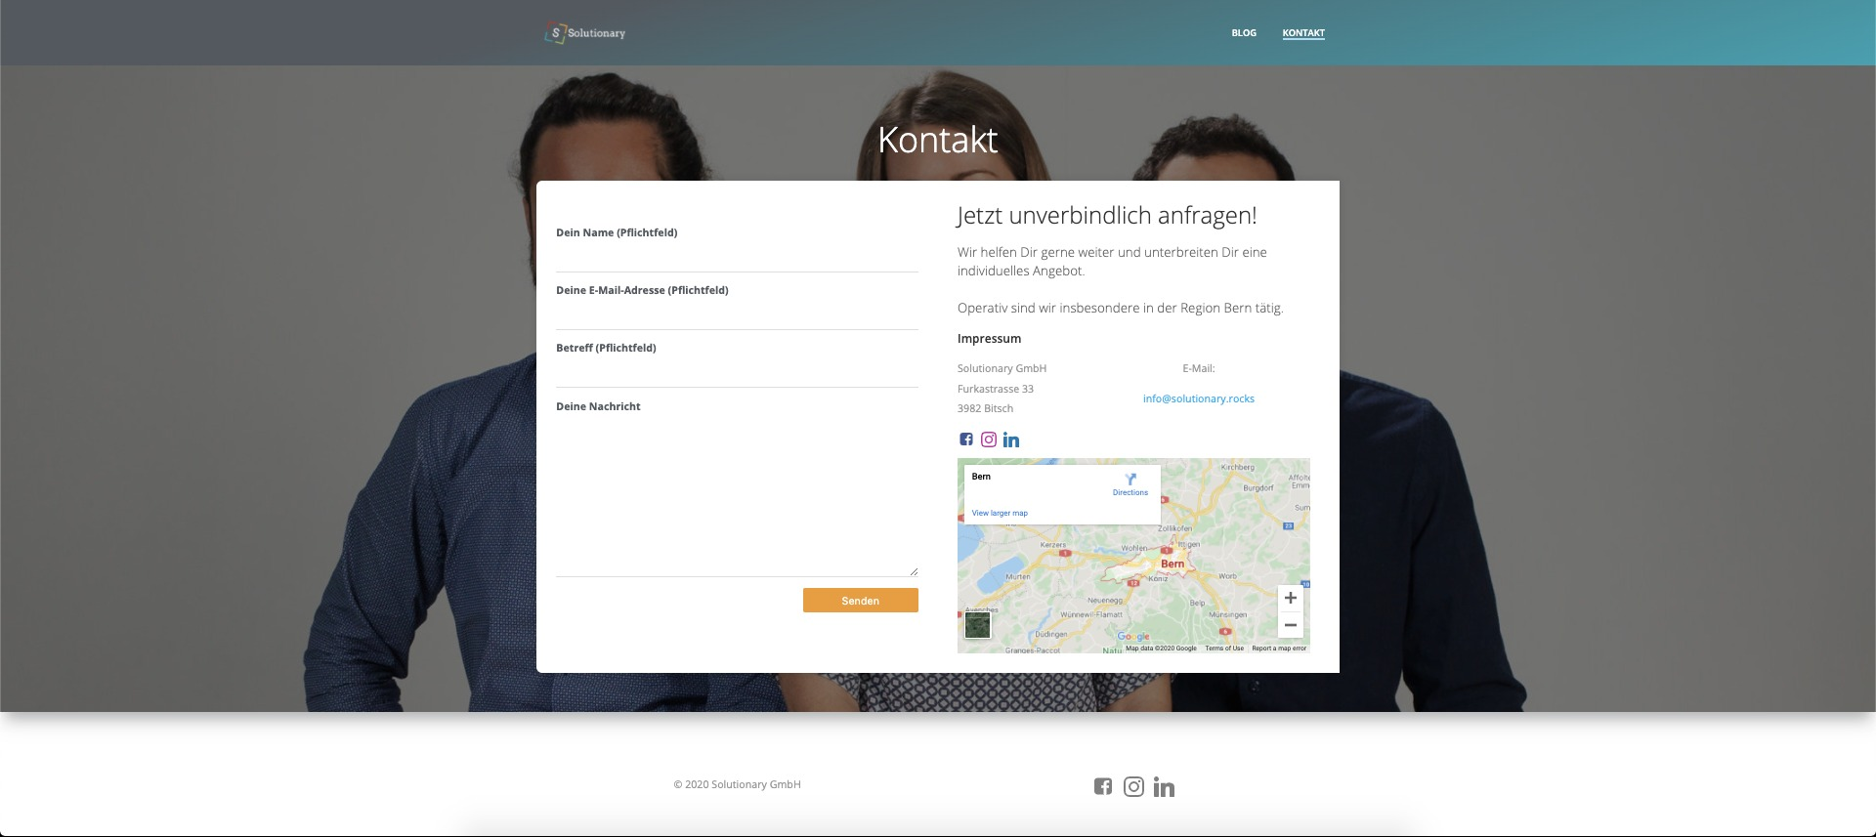
Team Ricotta
Introduction & Case
Solutionary GmbH
Startup founded in September 2019
HR Consultancy with three Experts as Founders
Customer-specific solutions for SME
Driven by individual solutions and long-term customer relationships
Our Case
Process of Contact requests of customers
Managed via contact form on website
Back-office employee (part-time) forwarding mails to experts
Goal is to find a solution for increasing customer enquiries

Slide 4
Team Ricotta
Problems
Back-office employee needs to check mailbox manually
Personnel expenses for BO must be paid for unnecessary, time-consuming work
Long waiting time for customers:
manual handling
part-time employment of BO
Wrong redirection of mails
No standardized category
BO employees no HR experts
Manual Check
High cost
Waiting Time
Human Failure

Slide 5
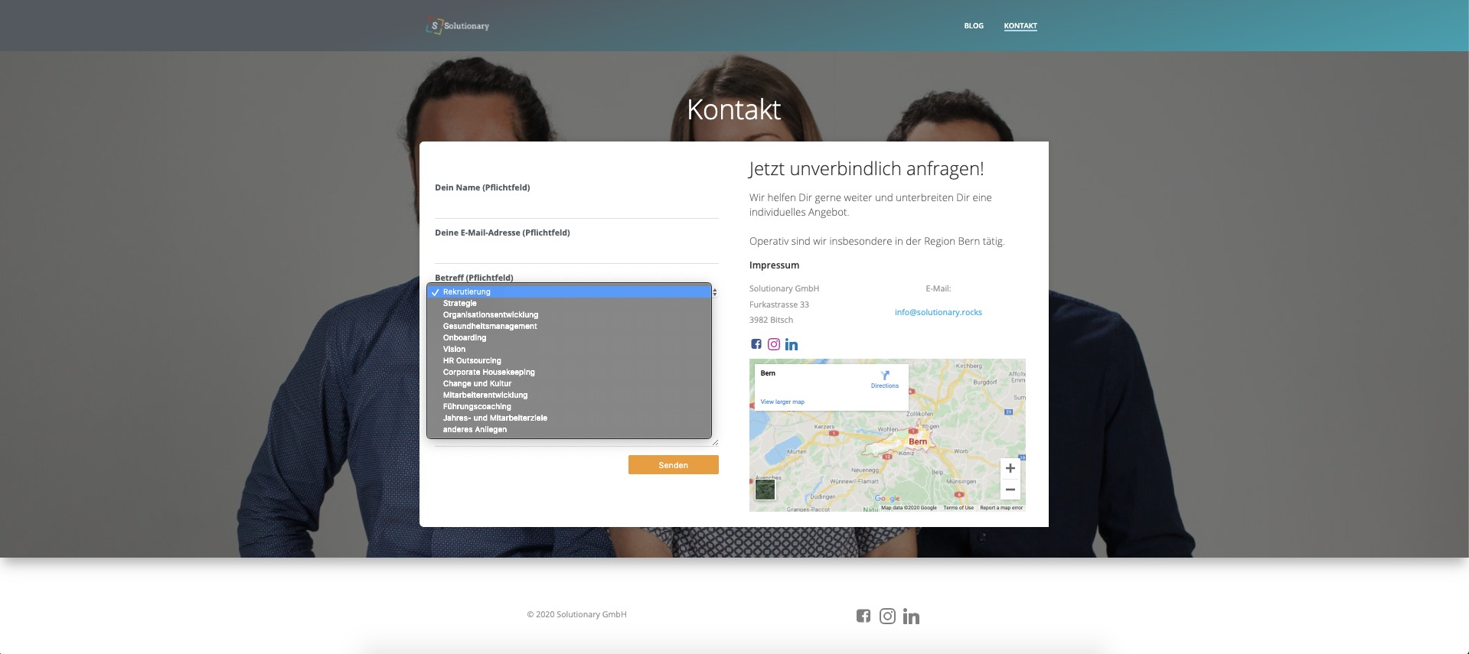
Team Ricotta
To-Be Process
Contact Form
Check Email
Decision Model
Dispatching
Fallback
Optimized contact form for Customer
Predefined selection criteria
Dropdown based on Data Analysis
Process for checking new emails
Triggered every 15 minutes automatically
Automation of identifying responsible Expert
Based on selection criteria of contact form
Contact request is sent to identified Expert
If selected “anderes Anliegen”, email is directed to back-office employee
Alternatively also, if there is an error

Slide 6
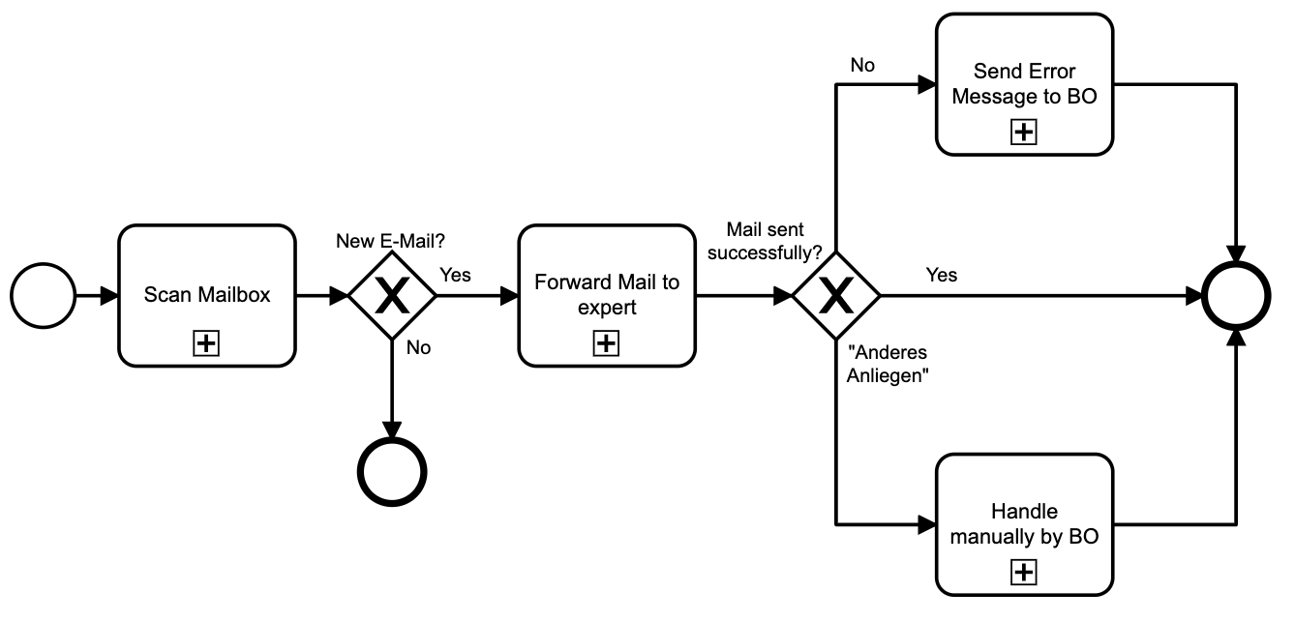
Team Ricotta
Schematic process

Slide 7
Team Ricotta
Video presentation
“
There are no secrets to success. It is the result of preparation, hard work, and learning from failure.
— Colin Powell
”
Link to the video on github

Slide 8
Team Ricotta
Benefits
No need to check the inbox manually
More time for core BO tasks
Direct forwarding of incoming emails
Automated redirection to responsible expert
Automated Check
Higher Productivity
Reduced Waiting Time
No Human Failure

Slide 9
Team Ricotta
Discussion
MEET THE SQUAD

Slide 10
Team Ricotta says
Thank you and take a COFFEE BREAK

Slide 11
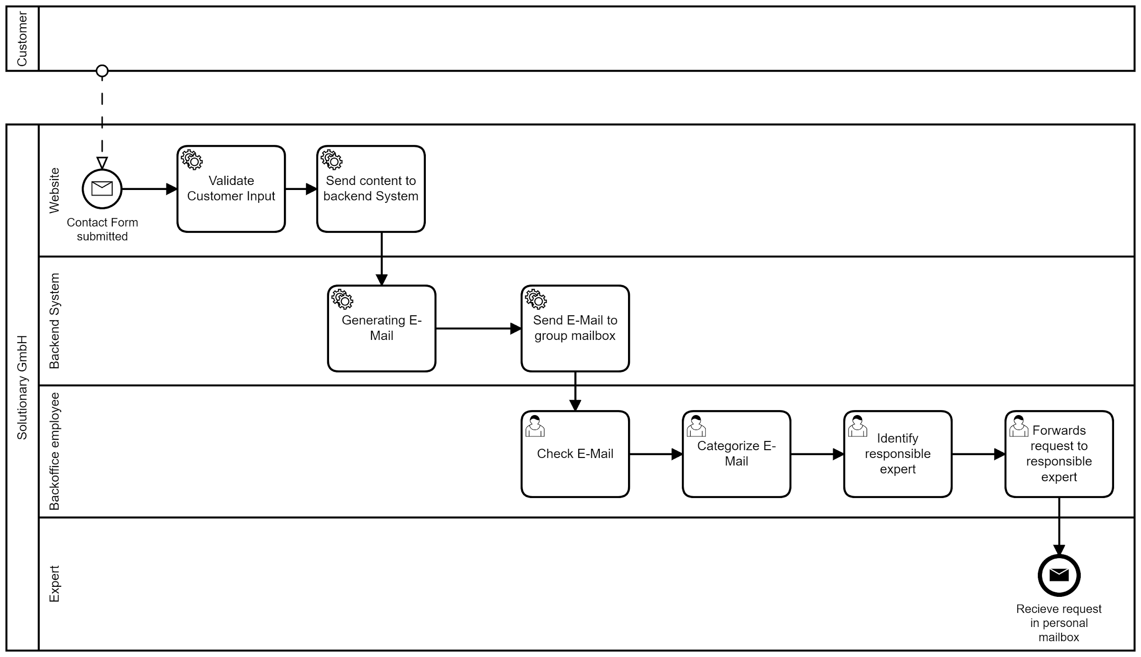
Team Ricotta
As-is Process model
“
”
Head to the wiki for more information

Slide 12
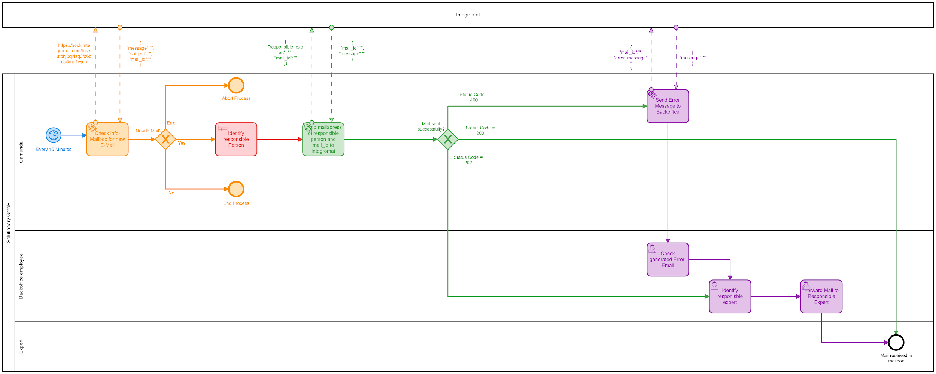
Team Ricotta
To-be Process model (Fallback Scenario)
“
”
Head to the wiki for more information

Slide 13
Team Ricotta
Why not AI?
“
No fitting soultion available
Pay to be able to determine the output (categories)
Not enough training data
company is still very young
data set not big enough to use AI
”
Head to the wiki for more information

